Slide 1
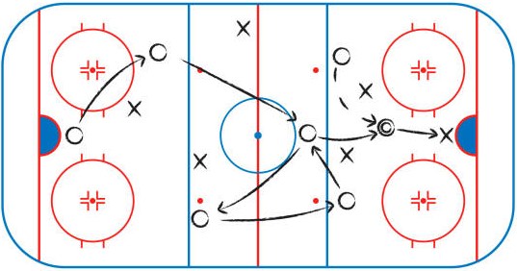
MVP - WHO HAS THE MOST HART?
PREDICTING THE HART MEMORIAL TROPHY RECIPIENT
Miranda Wallace
March 26th, 2023
STAT 445 Final Project

Slide 2


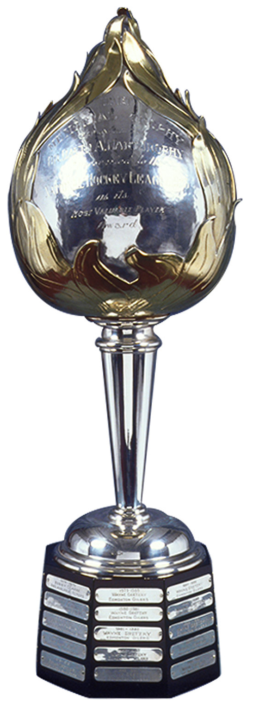
THE HART MEMORIAL TROPHY
Presented to the most valuable player (MVP)
Presented by the NHL in 1960
Dr. David Hart donated the original trophy in 1923
HHOF - Hart Memorial Trophy. (n.d.). Retrieved March 25, 2023, from https://www.hhof.com/thecollection/hartmemorialtrophy.html

Slide 3

WHO PICKS THE WINNER ?
Decided through a poll of the PHWA in all NHL cities
Poll takes place at the end of the regular season
1st Place | 2nd Place | 3rd Place | 4th Place | 5th Place
10 pts | 7 pts | 5 pts | 3 pts | 1 pts
About the PHWA – Professional Hockey Writers Association. (n.d.). Retrieved March 25, 2023, from https://www.thephwa.com/about-the-phwa/

Slide 4
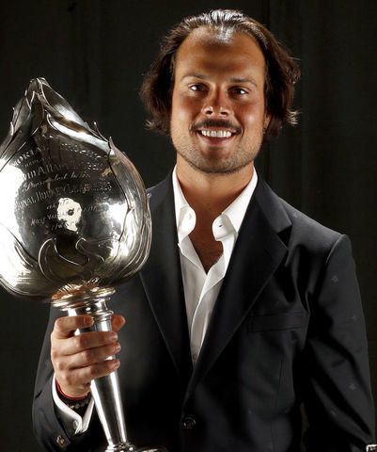
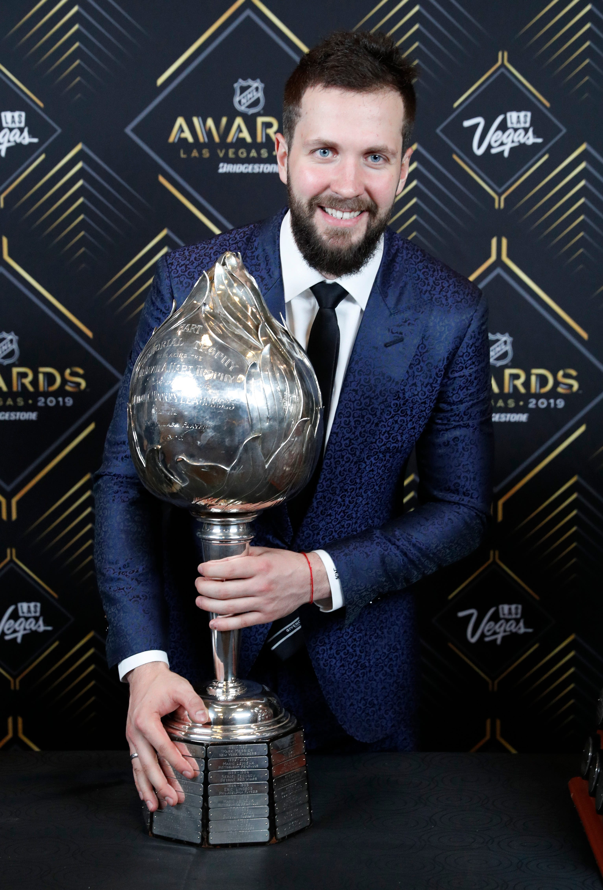
OBJECTIVES
Correctly predict the 2018-19 Hart Memorial Trophy recipient
Correctly predict the top 10 players voted for the Hart Memorial Trophy
2021-22 recipient : Auston Matthews
2018-19 recipient : Nikita Kucherov
O’Leary, S. (2022, June 21). Matthews wins Hart Trophy, Ted Lindsay Award after 60-goal campaign. TheScore.Com. https://www.thescore.com/nhl/news/2358513
Beacham, G. (n.d.). Tampa Bay’s Nikita Kucherov wins Hart, Lindsay at NHL Awards. The Detroit News. Retrieved March 25, 2023, from https://www.detroitnews.com/story/sports/nhl/2019/06/20/tampa-bays-nikita-kucherov-wins-hart-lindsay-nhl-awards/39605059/

Slide 5
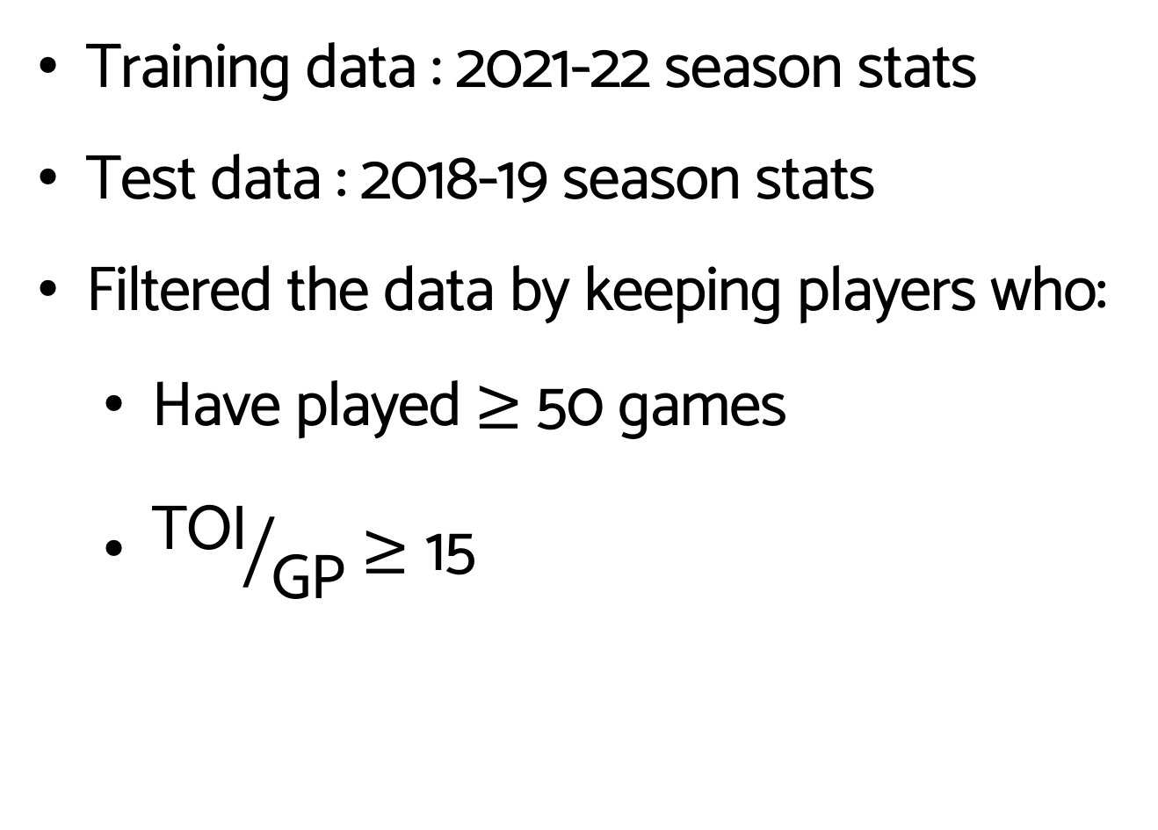
TRANSFORMING THE DATA
Training data : 2021-22 season stats
Test data : 2018-19 season stats
Filtered the data by keeping players who:
Have played $≥$50 games
${\text{TOI}}/{\text{GP}}≥\text{15}$

Slide 6

THE VARIABLES
Variable | Definition
Player | The hockey player’s name
Age | The player’s age
Tm | The team the player is on
Pos | The players position (C, LW, RW, D)
GP | The # of games the player was on the ice
G | The # of goals the player has made
A | The # of goals the player has assisted
PTS | The sum of goals and assists the player has made
+/- (plus/minus) | Rating calculated by: + 1 point for even-strength or short-handed goal the player’s team scores while they’re on the ice -1 point for even-strength or short-handed goal the opposing team scores while they’re on the ice
Nhl Logo png images | PNGEgg. (n.d.). Retrieved March 25, 2023, from https://www.pngegg.com/en/search?q=nhl+Logo

Slide 7
THE VARIABLES
Variable | Definition
PIM | The total # of penalty minutes the player received
PS | Point share – an estimate of the # of points contributed by a player
TOI | Time on ice (minutes)
OPS | Offensive Point Share – an estimate of the # of points contributed by a player due to their offense
DPS | Defensive Point Share – an estimate of the # of points contributed by a player due to their defense
Vote Percent | The percentage of votes a player has received in favour of winning the Hart Memorial Trophy
Nhl Logo png images | PNGEgg. (n.d.). Retrieved March 25, 2023, from https://www.pngegg.com/en/search?q=nhl+Logo

Slide 8
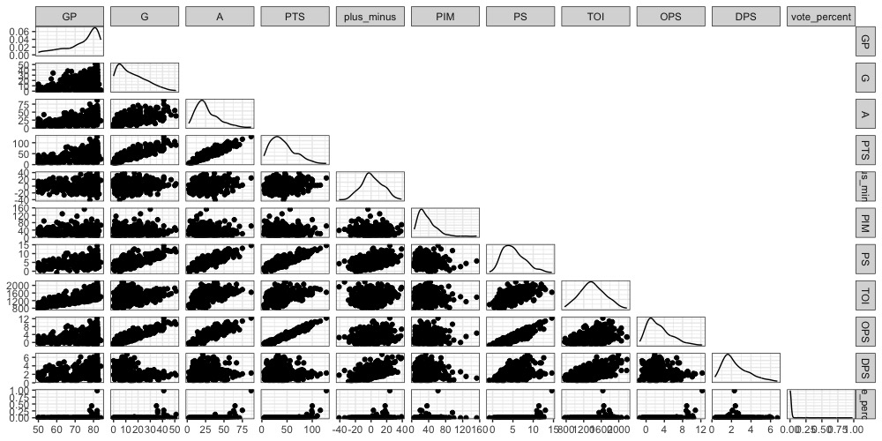
Figure 1. Pairs Plot of the Filtered 2018-19 Season Data

Slide 9

Figure 2. Pairs Plot of the Filtered 2021-22 Season Data

Slide 10

THE MODELS – LINEAR REGRESSION
COEFFICIENTS:
 | ESTIMATE
INTERCEPT | -0.348
GP | 0.00238
G | -0.179
A | -0.104
PLUS_MINUS | 0.0355
PIM | -0.00487
PS | 5.39
TOI | 0.00195
OPS | -3.56
DPS | -5.97
Test MSE = 33.08424
Pair of ice hockey skates high contrast. (n.d.). Retrieved March 25, 2023, from https://www.vexels.com/png-svg/preview/241275/pair-of-ice-hockey-skates-high-contrast
Notes:
Jordan Binnington is a goalie and I didn’t include goalie data

Slide 11
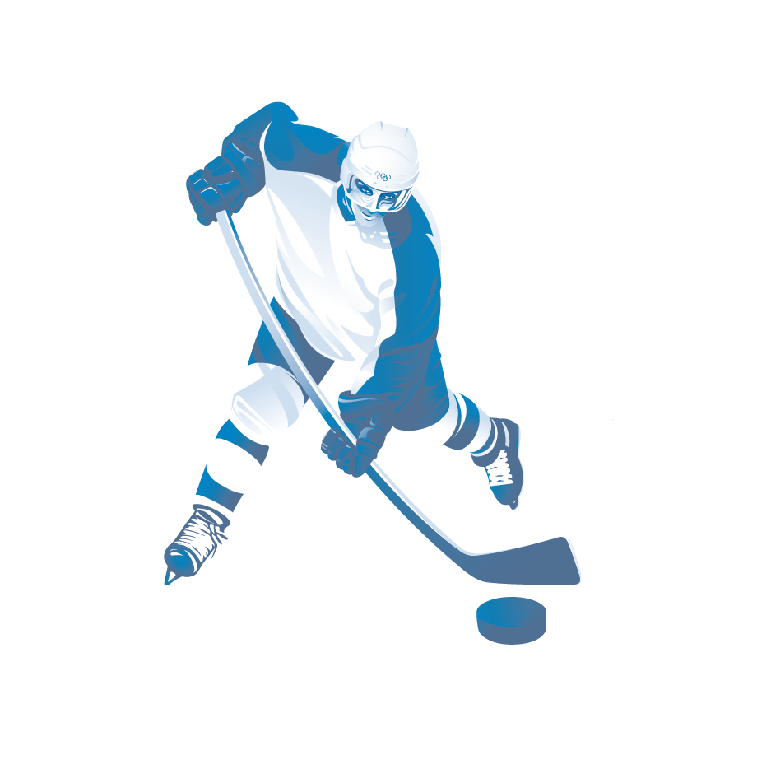
LINEAR REGRESSION : PREDICTED TOP 10
PREDICTED RANK | NAME | VOTE % | ACTUAL RANK
1 | Nikita Kucherov | 98.07 % | 1
2 | Connor McDavid | 27.19 % | 3
3 | Steven Stamkos | 0.70 % | 14
4 | John Tavares | 0.41 % | 17
5 | Patrick Kane | 7.31 % | 8
6 | Leon Draisaitl | 0.000 % | N/A
7 | Braydon Point | 0.18 % | 21
8 | Sidney Crosby | 43.22 % | 2
9 | David Pastmak | 0.0000 % | N/A
10 | Alex Ovechkin | 12.46 % | 7
Ice Hockey Png Clipart—Transparent Ice Hockey Clipart, Png Download—Vhv. (n.d.). Retrieved March 25, 2023, from https://www.vhv.rs/viewpic/howmboh_ice-hockey-png-clipart-transparent-ice-hockey-clipart/

Slide 12
LINEAR REGRESSION : ACTUAL TOP 10
ACTUAL RANK | NAME | VOTE % | PREDICTED RANK
1 | Nikita Kucherov | 98.07 % | 1
2 | Sidney Crosby | 43.22 % | 8
3 | Connor McDavid | 27.19 % | 2
4 | Johnny Gaudreau | 25.85 % | 13
5 | Brad Marchand | 18.83 % | 15
6 | Nathan Mackinnon | 15.50 % | 11
7 | Alex Ovechkin | 12.46 % | 10
8 | Patrick Kane | 7.31 % | 5
9 | Mark Giordano | 3.86 % | 20
10 | Sebastian Aho Jordan Binnington | 1.23 % | 32 N/A
Ice Hockey Png Clipart—Transparent Ice Hockey Clipart, Png Download—Vhv. (n.d.). Retrieved March 25, 2023, from https://www.vhv.rs/viewpic/howmboh_ice-hockey-png-clipart-transparent-ice-hockey-clipart/
Notes:
Jordan Binnington is a goalie and I didn’t include goalie data

Slide 13
THE MODELS – RIDGE REGRESSION
COEFFICIENTS:
 | ESTIMATE
INTERCEPT | -1.18
GP | -0.00440
G | 0.0263
A | 0.0174
PLUS_MINUS | 0.00970
PIM | -0.00180
PS | 0.124
TOI | 0.000129
OPS | 0.158
DPS | -0.0102
Test MSE = 33.99761
Pair of ice hockey skates high contrast. (n.d.). Retrieved March 25, 2023, from https://www.vexels.com/png-svg/preview/241275/pair-of-ice-hockey-skates-high-contrast

Slide 14
RIDGE REGRESSION : PREDICTED TOP 10
PREDICTED RANK | NAME | VOTE % | ACTUAL RANK
1 | Nikita Kucherov | 98.07 % | 1
2 | Connor McDavid | 27.19 % | 3
3 | Leon Draisaitl | 0.000 % | N/A
4 | Patrick Kane | 7.31 % | 8
5 | Nathan Mackinnon | 15.50% | 6
6 | Steven Stamkos | 0.70 % | 14
7 | Brayden Point | 0.18 % | 21
8 | Sidney Crosby | 43.22 % | 2
9 | Brad Marchand | 18.83 % | 5
10 | John Tavares | 0.41 % | 17
Ice Hockey Png Clipart—Transparent Ice Hockey Clipart, Png Download—Vhv. (n.d.). Retrieved March 25, 2023, from https://www.vhv.rs/viewpic/howmboh_ice-hockey-png-clipart-transparent-ice-hockey-clipart/

Slide 15
RIDGE REGRESSION : ACTUAL TOP 10
ACTUAL RANK | NAME | VOTE % | PREDICTED RANK
1 | Nikita Kucherov | 98.07 % | 1
2 | Sidney Crosby | 43.22 % | 8
3 | Connor McDavid | 27.19 % | 2
4 | Johnny Gaudreau | 25.85 % | 11
5 | Brad Marchand | 18.83 % | 9
6 | Nathan Mackinnon | 15.50 % | 5
7 | Alex Ovechkin | 12.46 % | 12
8 | Patrick Kane | 7.31 % | 4
9 | Mark Giordano | 3.86 % | 16
10 | Sebastian Aho Jordan Binnington | 1.23 % | 21 N/A
Ice Hockey Png Clipart—Transparent Ice Hockey Clipart, Png Download—Vhv. (n.d.). Retrieved March 25, 2023, from https://www.vhv.rs/viewpic/howmboh_ice-hockey-png-clipart-transparent-ice-hockey-clipart/
Notes:
Jordan Binnington is a goalie and I didn’t include goalie data

Slide 16
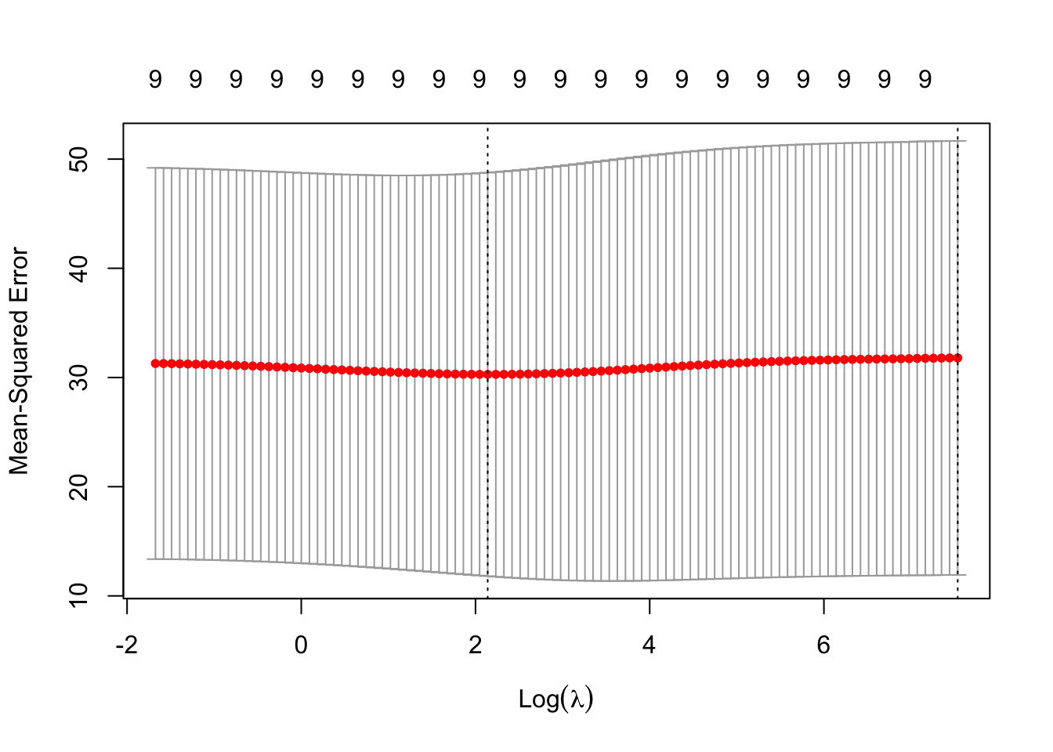

RIDGE REGRESSION PLOT
λ_{BEST} = 8.501

Slide 17
THE MODELS – LASSO
COEFFICIENTS:
 | ESTIMATE
INTERCEPT | -1.38
GP
G
A
PLUS_MINUS
PIM
PS | 0.108
TOI
OPS | 0.506
DPS
Test MSE = 33.47676
Pair of ice hockey skates high contrast. (n.d.). Retrieved March 25, 2023, from https://www.vexels.com/png-svg/preview/241275/pair-of-ice-hockey-skates-high-contrast

Slide 18
LASSO : PREDICTED TOP 10
PREDICTED RANK | NAME | VOTE % | ACTUAL RANK
1 | Nikita Kucherov | 98.07 % | 1
2 | Connor McDavid | 27.19 % | 3
3 | Leon Draisaitl | 0.000 % | N/A
4 | Patrick Kane | 7.31 % | 8
5 | Steven Stamkos | 0.70 % | 14
6 | John Tavares | 0.41 % | 17
7 | Brad Marchand | 18.83 % | 5
8 | Nathan Mackinnon | 15.50 % | 6
9 | Alex Ovechkin | 12.46 % | 7
10 | Brayden Point | 0.18 % | 21
Ice Hockey Png Clipart—Transparent Ice Hockey Clipart, Png Download—Vhv. (n.d.). Retrieved March 25, 2023, from https://www.vhv.rs/viewpic/howmboh_ice-hockey-png-clipart-transparent-ice-hockey-clipart/

Slide 19
LASSO : ACTUAL TOP 10
ACTUAL RANK | NAME | VOTE % | PREDICTED RANK
1 | Nikita Kucherov | 98.07 % | 1
2 | Sidney Crosby | 43.22 % | 11
3 | Connor McDavid | 27.19 % | 2
4 | Johnny Gaudreau | 25.85 % | 12
5 | Brad Marchand | 18.83 % | 7
6 | Nathan Mackinnon | 15.50 % | 8
7 | Alex Ovechkin | 12.46 % | 9
8 | Patrick Kane | 7.31 % | 4
9 | Mark Giordano | 3.86 % | 23
10 | Sebastian Aho Jordan Binnington | 1.23 % | 28 N/A
Ice Hockey Png Clipart—Transparent Ice Hockey Clipart, Png Download—Vhv. (n.d.). Retrieved March 25, 2023, from https://www.vhv.rs/viewpic/howmboh_ice-hockey-png-clipart-transparent-ice-hockey-clipart/
Notes:
Jordan Binnington is a goalie and I didn’t include goalie data

Slide 20
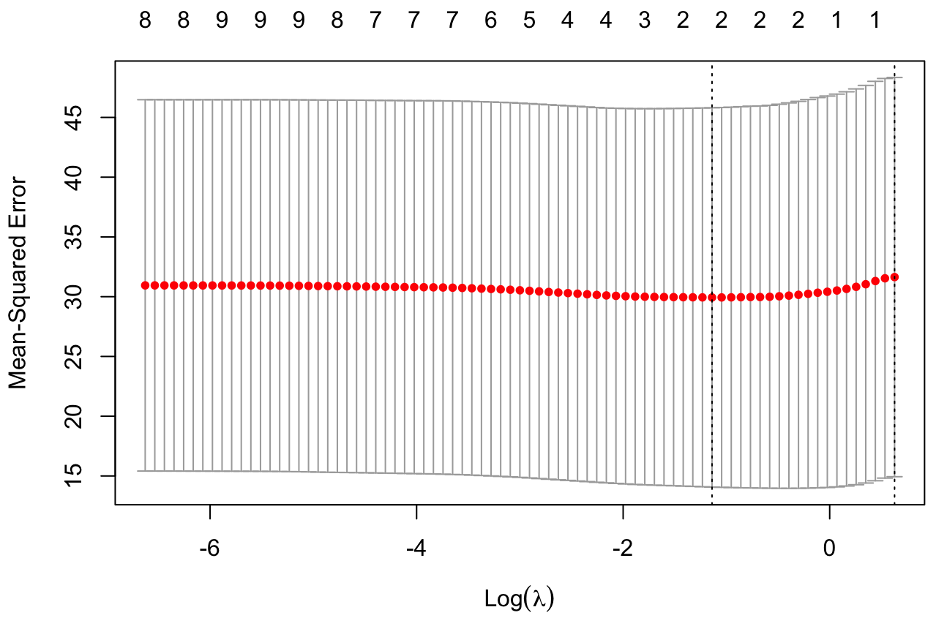
LASSO REGRESSION PLOT
λ_{BEST} = 0.3200

Slide 21
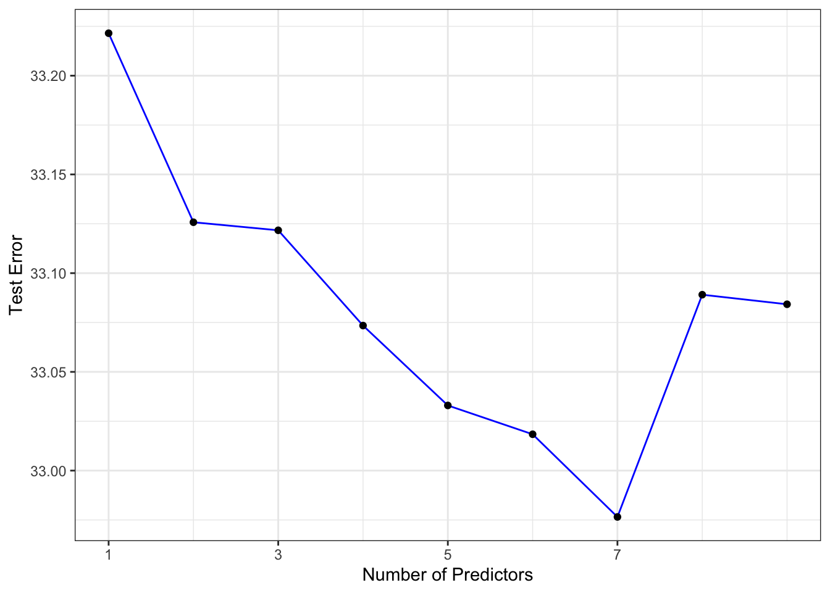
SUBSET SELECTION PLOT
OPTIMAL # OF PREDICTORS = 7

Slide 22
THE MODELS – SUBSET SELECTION
COEFFICIENTS:
 | ESTIMATE
INTERCEPT | 1.058
GP
G | -0.181
A | 0.0555
PLUS_MINUS | 0.0399
PIM
PS | 4.435
TOI | -0.00140
OPS | -3.149
DPS | -4.778
Test MSE = 31.78458
Pair of ice hockey skates high contrast. (n.d.). Retrieved March 25, 2023, from https://www.vexels.com/png-svg/preview/241275/pair-of-ice-hockey-skates-high-contrast

Slide 23
SUBSET SELECTION : PREDICTED TOP 10
PREDICTED RANK | NAME | VOTE % | ACTUAL RANK
1 | Nikita Kucherov | 98.07 % | 1
2 | Connor McDavid | 27.19 % | 3
3 | Sydney Crosby | 43.22 % | 2
4 | Mitch Marner | 0.000 % | N/A
5 | Brad Marchand | 18.83 % | 5
6 | Brent Burns | 0.29 % | 19
7 | Johnny Gaudreau | 25.85 % | 4
8 | Patrick Kane | 7.31 % | 8
9 | Patrice Bergeron | 0.47 % | 15
10 | Mark Giordano | 3.86 % | 9
Ice Hockey Png Clipart—Transparent Ice Hockey Clipart, Png Download—Vhv. (n.d.). Retrieved March 25, 2023, from https://www.vhv.rs/viewpic/howmboh_ice-hockey-png-clipart-transparent-ice-hockey-clipart/

Slide 24
SUBSET SELECTION : ACTUAL TOP 10
ACTUAL RANK | NAME | VOTE % | PREDICTED RANK
1 | Nikita Kucherov | 98.07 % | 1
2 | Sidney Crosby | 43.22 % | 3
3 | Connor McDavid | 27.19 % | 2
4 | Johnny Gaudreau | 25.85 % | 7
5 | Brad Marchand | 18.83 % | 5
6 | Nathan Mackinnon | 15.50 % | 18
7 | Alex Ovechkin | 12.46 % | 56
8 | Patrick Kane | 7.31 % | 8
9 | Mark Giordano | 3.86 % | 10
10 | Sebastian Aho Jordan Binnington | 1.23 % | 25 N/A
Ice Hockey Png Clipart—Transparent Ice Hockey Clipart, Png Download—Vhv. (n.d.). Retrieved March 25, 2023, from https://www.vhv.rs/viewpic/howmboh_ice-hockey-png-clipart-transparent-ice-hockey-clipart/
Notes:
Jordan Binnington is a goalie and I didn’t include goalie data

Slide 25
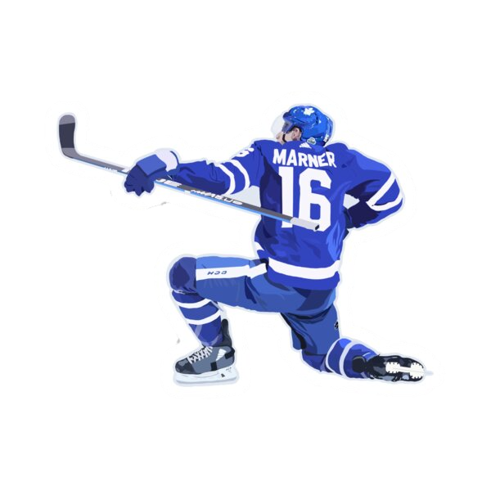
SUMMARY & COMPARING MODEL RESULTS
 | LINEAR | RIDGE | LASSO | SUBSET
MSE_{TEST} | 33.08424 | 33.99761 | 33.47676 | 31.78458
PREDICTED WINNER | Nikita Kucherov | Nikita Kucherov | Nikita Kucherov | Nikita Kucherov
ACTUAL WINNER | Nikita Kucherov | Nikita Kucherov | Nikita Kucherov | Nikita Kucherov
PREDICTEDTOP 10 | 5 correct players | 6 correct players | 6 correct players | 7 correct players
BEST MODEL : SUBSET SELECTION
https://www.redbubble.com/i/sticker/Mitch-Marner-by-livcharb/56665970.EJUG5

